Slide 1

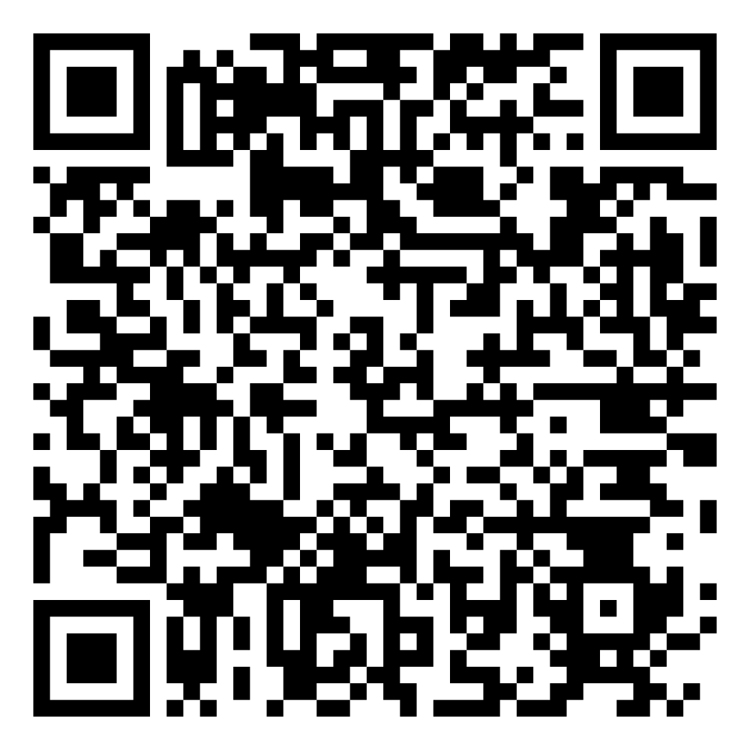
STOP THE CUTS x
JUNE 10TH 12PM
DAM SQUARE AMSTERDAM
NATIONAL HIGHER
EDUCATION STRIKE x
The upcoming elections should be about our education. Join us and make your voice heard!

