Slide 1
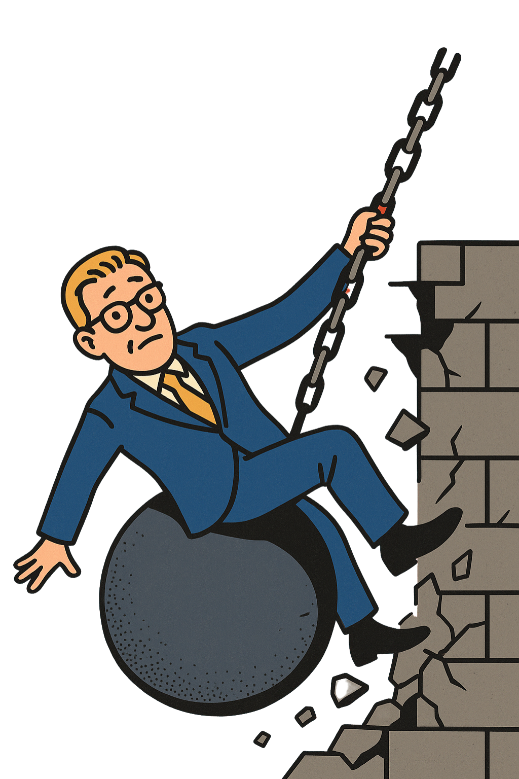
STOP THE CUTS JUNE 10TH NATIONAL HIGHER EDUCATION STRIKE

Slide 2
SHORT HISTORY
The government is making unprecedented cuts to our education. In November, 25,000 of us stood on the Malieveld. The penalty for graduating late was scrapped.
But €1.1 billion in cuts remained. So we rose up again.
In March and April, 32,500 students and staff went on strike, to show we won’t stand for this.
But what does the government do? They added another €400 million in cuts.

Slide 3
UNACCEPTABLE!
These aren’t just cuts.
THIS IS A DEMOLITION.
Of our studies and our jobs.
Of the international character of our education and research.
Of critical and independent science.
This is an attack on our resilient, democratic rule of law.
An attack on our future.

Slide 4
JUNE 10TH: JOIN US
We’re striking again on June 10th. Because we know: persistence works. Protest works.
Our demand: ALL CUTS MUST BE RESERVED AND THE INTERNALIZATION IN BALANCE ACT MUST BE ABOLISHED.

Slide 5
WHAT YOU CAN DO
Spread information – Help with flyer and poster campaigns at your institution.
Build solidarity – Involve your colleagues and/or fellow students and encourage them to become FNV members, so we stand even stronger.
Show that you're taking action – Use the banner in your email signature or speak out on social media with the hashtag #KabinetSlooptHogerOnderwijs.

Slide 6
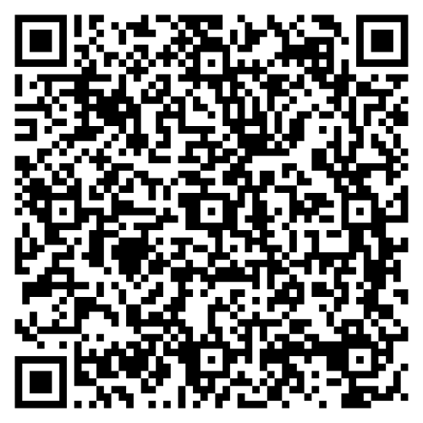
SIGN UP, ACTION MATERIAL AND MORE INFORMATION

